Slide 1
DBMS Project
Hospital management system
Presented by:
Paras Sharma, AE-1236
Harshit Raizada, AE-1220
Kabir Khurana, AE-1225

Slide 2
Problem statement:
Design and implement a Hospital Management System (HMS) to streamline the operations of a hospital. The system should maintain information about patients, doctors, medical services, and other relevant entities. The primary objective is to create a centralized database-driven system that efficiently manages various aspects of hospital operations.

Slide 3
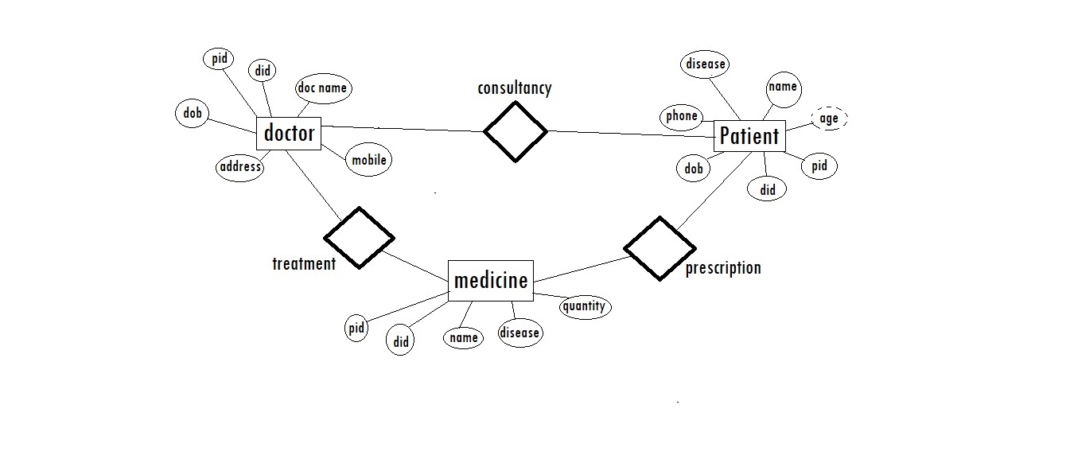
ER diagram:

